Slide 1
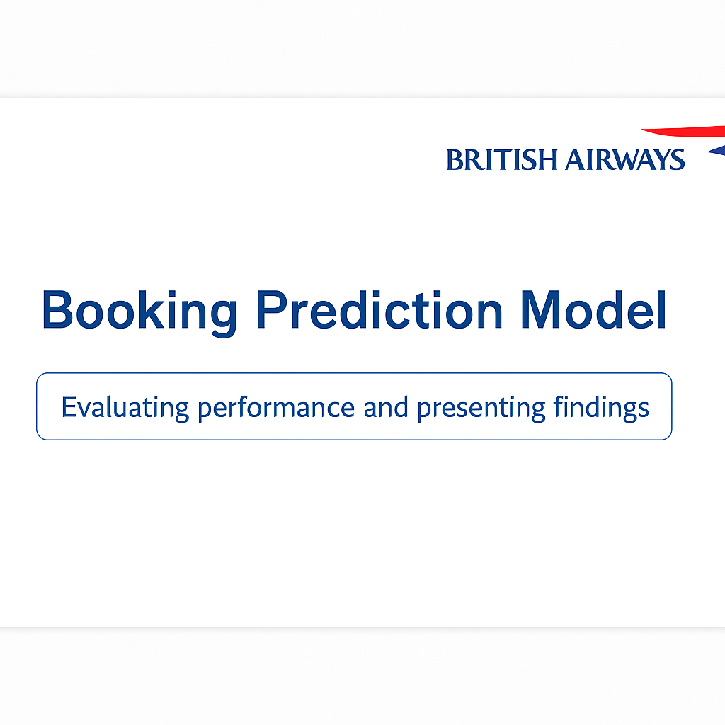

Slide 2

Project Overview Title: Project Objective & Dataset Summary
Content:
Objective: Predict likelihood of customer completing a booking.
Business Impact: Improve targeting, reduce churn, optimize marketing.
Data Source: British Airways customer booking data.
Key Fields: purchase lead time, flight duration, number of passengers, booking origin, etc.
Imbalance Note: Only 15% of entries were positive bookings.

Slide 3
Modeling Approach Title: Data Preparation & Model Selection
Content:
Data Processing:
One-hot encoding of categorical variables.
Train-test split (80/20).
Handling Imbalance: Applied SMOTE to balance class distribution.
Before: 34,002 (non-bookings), 5,998 (bookings)
After: 34,002 each.
Model Used: Random Forest Classifier
Chosen for interpretability, robustness, and ability to handle mixed types.

Slide 4
Model Performance Title: Model Evaluation Metrics
Content:
Test Set Performance:
Accuracy: 84%
Precision (booking=1): 0.45
Recall (booking=1): 0.23
F1 Score: 0.30
Interpretation:
Model favors non-bookings (class imbalance effect).
High precision means it’s cautious when predicting bookings.
Confusion Matrix: (Include as visual)

Slide 5
Feature Importance Title: Top Predictive Factors
Content:
Top Feaures:
booking_origin_Malaysia
flight_duration
purchase_lead
length_of_stay
flight_hour
Insights:
Passengers from Malaysia show higher booking rates.
Early purchases and longer stays correlate with bookings.
Visuals:
Feature importance bar chart

Slide 6
Key Takeaways & Recommendations Title: Summary & Next Steps
Content:
Key Takeaways:
Random Forest achieved strong accuracy but low recall.
Booking origin and timing factors are strong predictors.
Limitations:
Class imbalance affects recall.
Some features may need better encoding or granularity.
Next Steps:
Try other models (XGBoost, logistic regression).
Tune hyperparameters and threshold.
Deploy model for lead scoring.

